Slide 1
Photography

Slide 2
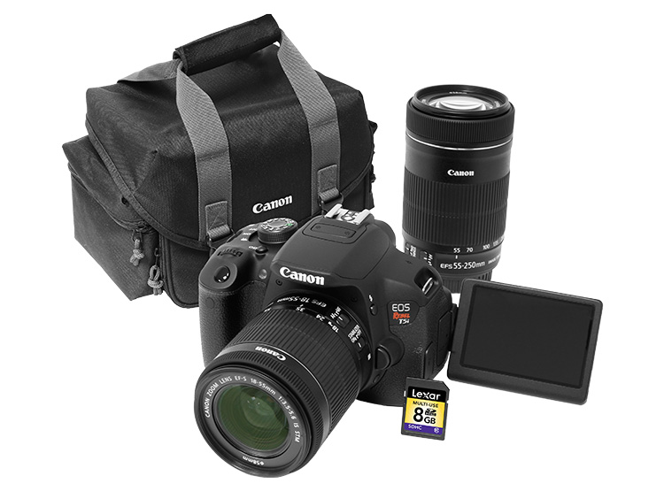
Photography
This presentation will cover some tips and tricks to help make you a better photographer.
We will focus mainly on techniques involving digital cameras (which you will learn more about later), but many of these “rules” also apply to conventional film AND video cameras.

Slide 3
Photography
Know Your Camera:
As with any piece of electronic equipment, you want to take the time to learn how to operate your camera correctly.
The first step is reading over the manual.
This is important, since you want to ensure you are familiar with basic operations, charging instructions, how to load memory cards, transfer images to your computer, etc.
For your first shots, limit the settings you change so that you can get started quickly.

Slide 4
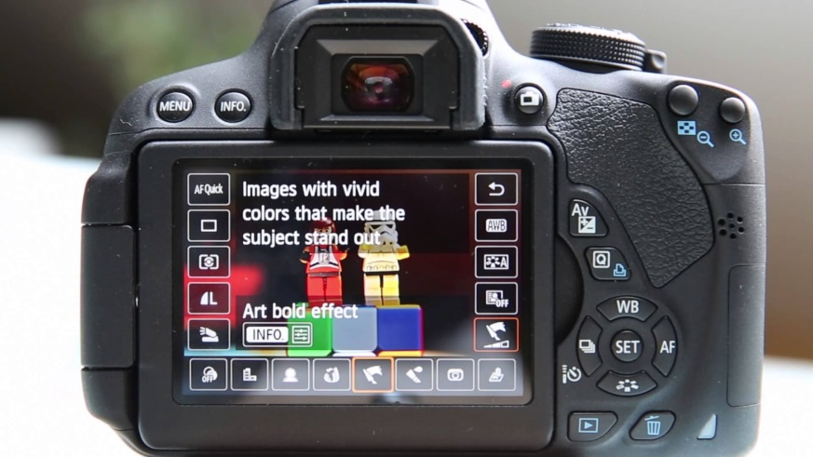
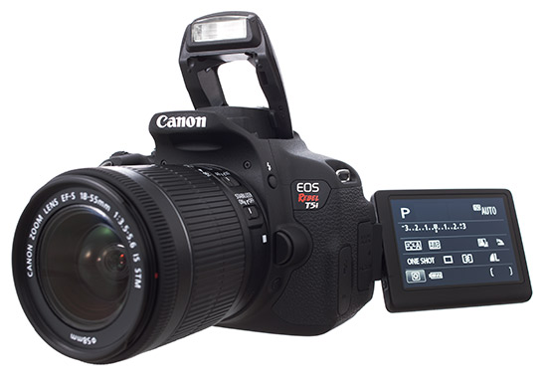
Photography
Digital SLR Camera

Slide 5
Photography
Basic Camera Features
Most digital SLR cameras have similar basic features, including:
White Balance Adjustment
Aperture/Exposure Control
Shutter Speed Control
Quality/Sharpness Settings
Red-Eye Reduction
“Macro” Mode and Preset Photo Modes
Video/Audio Recording Capability

Slide 6
Photography
Composition Tips
Your initial impulse may be to use the camera's LCD monitor instead of the viewfinder to compose pictures.
You can do this, but this technique can also result in "soft" focus images; holding a lightweight camera away from your body is an invitation for motion blur.
Holding the viewfinder to your eye provides built-in stabilization that helps ensure sharp images.
To stabilize the camera, hold it with one hand, and support it with the other.
Keep your elbows close at your side. Stand with your feet shoulder-width apart to steady the camera.

Slide 7
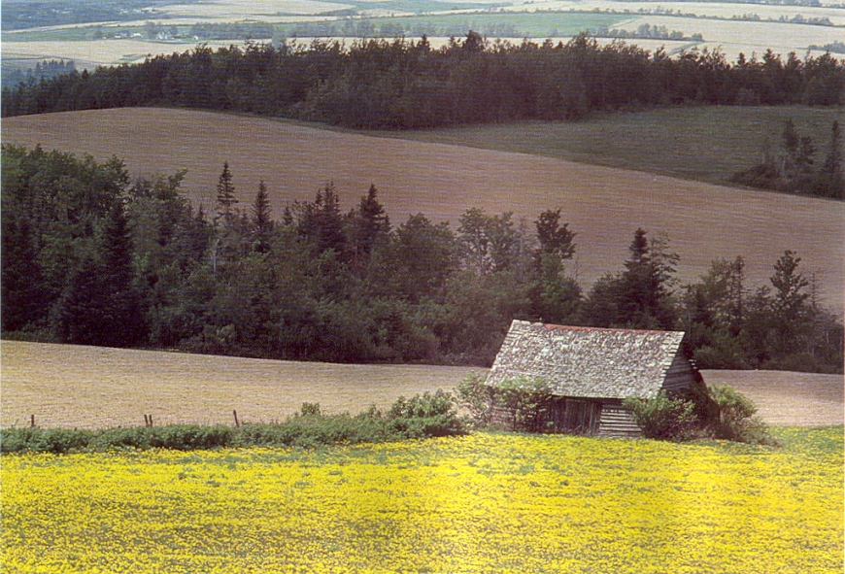
Photography
Rule of Thirds
you should place subjects at specific points on the screen creates powerful visual interest

Slide 8
Photography
Rule of Thirds
Our eyes map out visual space in thirds.
We follow a path through the scene by moving to intersection points of the third lines.
2
3
1
4
Most important visual point

Slide 9
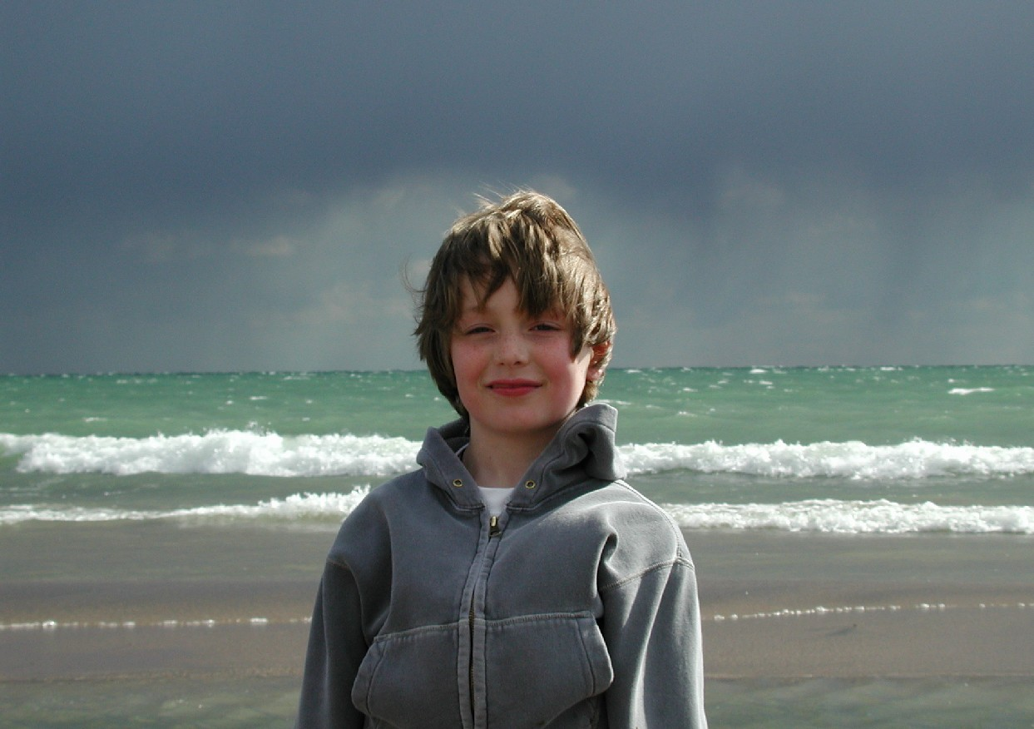
Photography
Rule of Thirds
Objects placed at the dead centre on a photo tend to look boring.

Slide 10
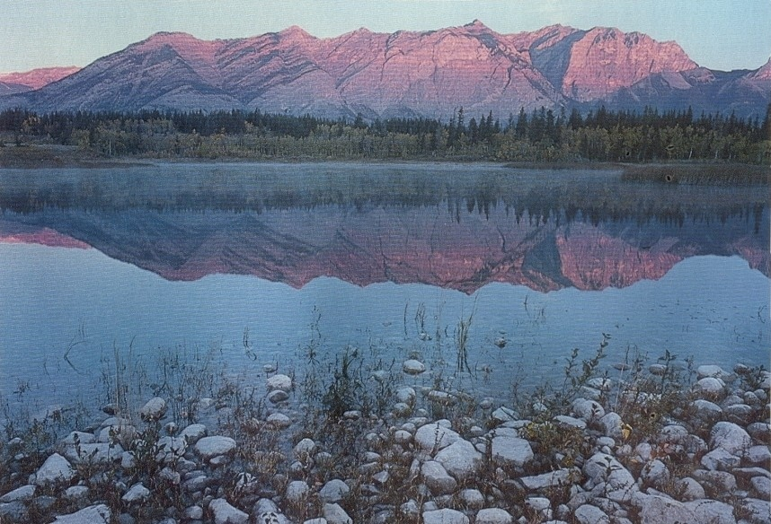
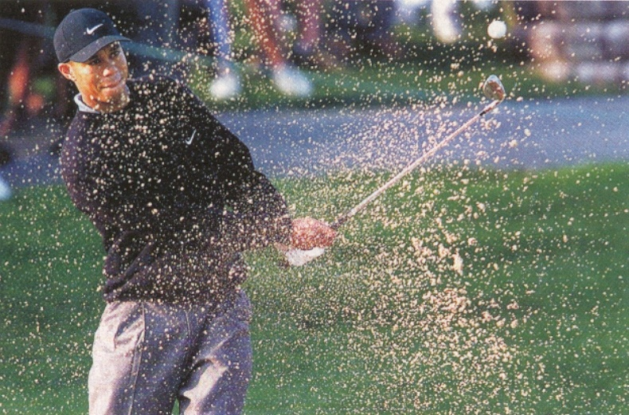
Photography
Rule of Thirds
Move subjects a little off centre and things start to look good!

Slide 11
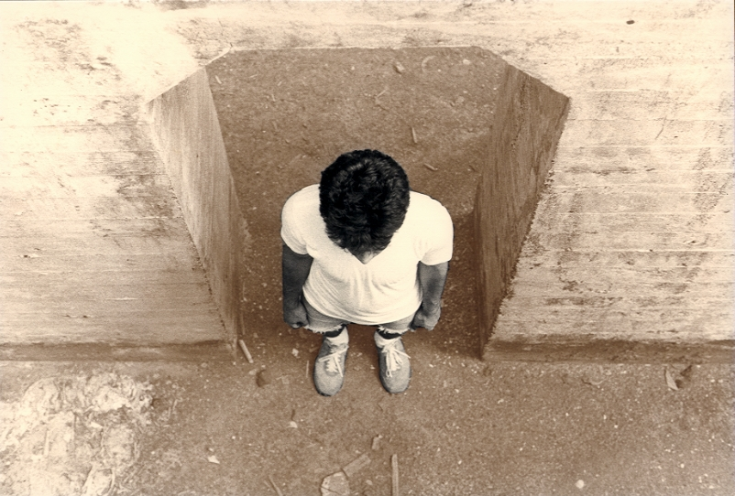
Photography
Rule of Thirds
Sometimes the rule can be broken . . .
Centring a subject can work well when the subject is powerful or unusual.

Slide 12
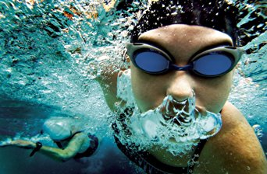
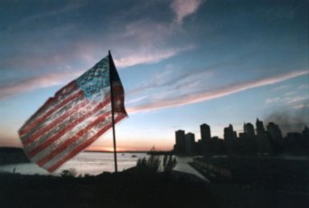
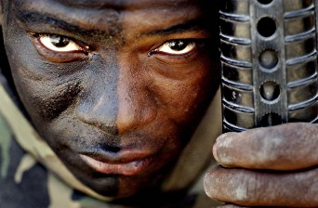
Photography
Rule of Thirds

Slide 13
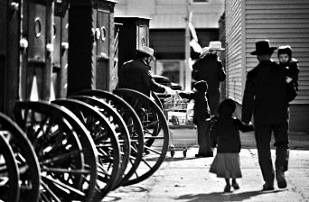
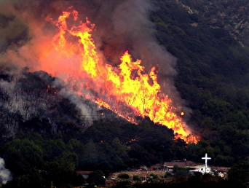
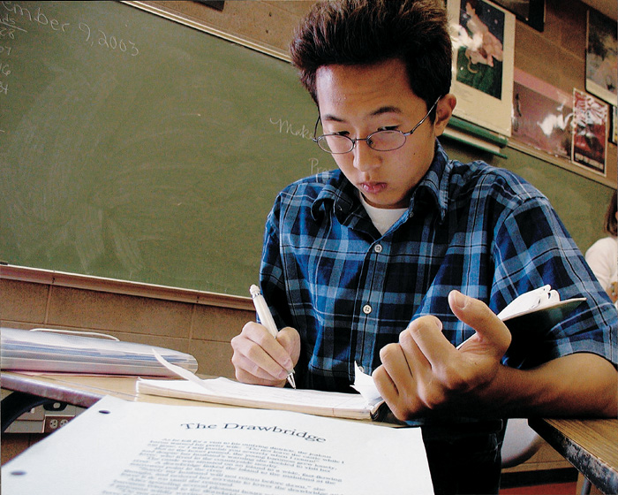
Photography
LEADING LINES/REPETITION

Slide 14
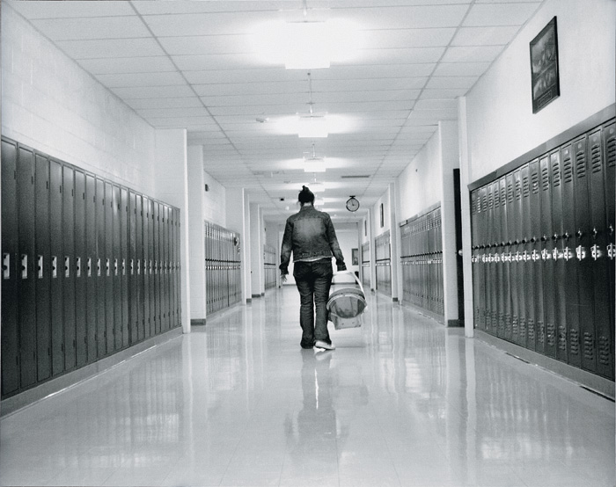
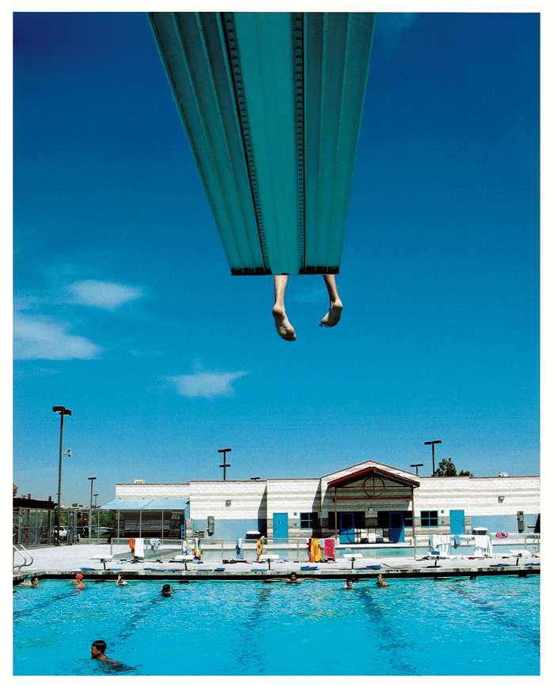
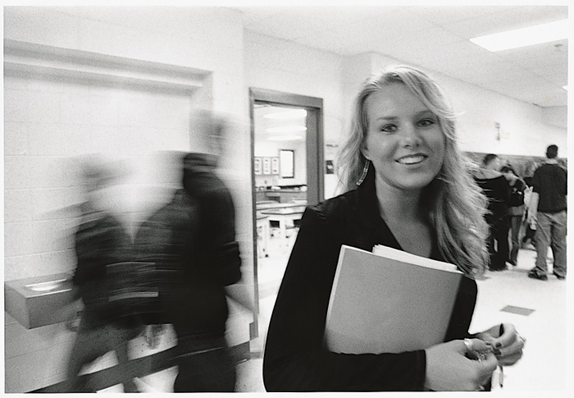
Photography
MORE LEADING LINES/SHUTTER SPEED

Slide 15
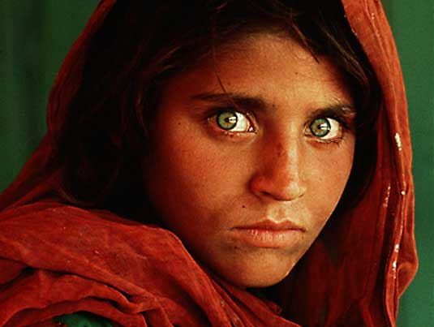
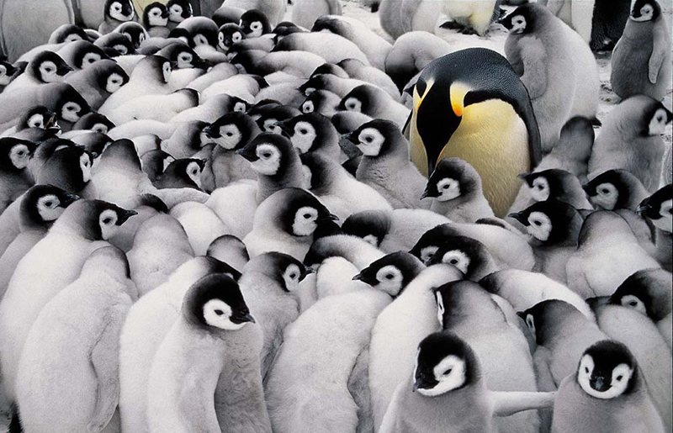
Photography
POWERFUL COMPOSITION

Slide 16
Photography
Shutter Speed
A camera’s shutter speed refers to the length of time the shutter stays open, allowing light to enter the camera.
The faster the shutter speed, the less light that enters the camera and the quicker the image is captured.
A good photographer knows how to make aperture settings and shutter speed work together!
As with exposure settings, most digital cameras have auto-shutter modes.
You should be aware of how different shutter speeds affect an image.

Slide 17
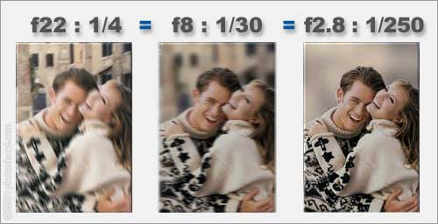
Photography
Shutter Speed
Shutter speed also needs to be adjusted depending on the type of subject being photographed.
Fast moving objects require a fast shutter speed (such as 1/500 of a second) – sports or actions shots
For shutter speeds lower than 1/125, you should use a tripod or the image will likely appear blurry

Slide 18
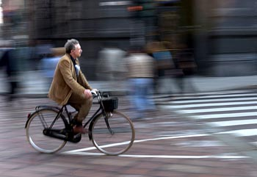
Photography
Shutter Speed
A slow shutter speed is used to blur the background as the camera pans along with the cyclist.

Slide 19
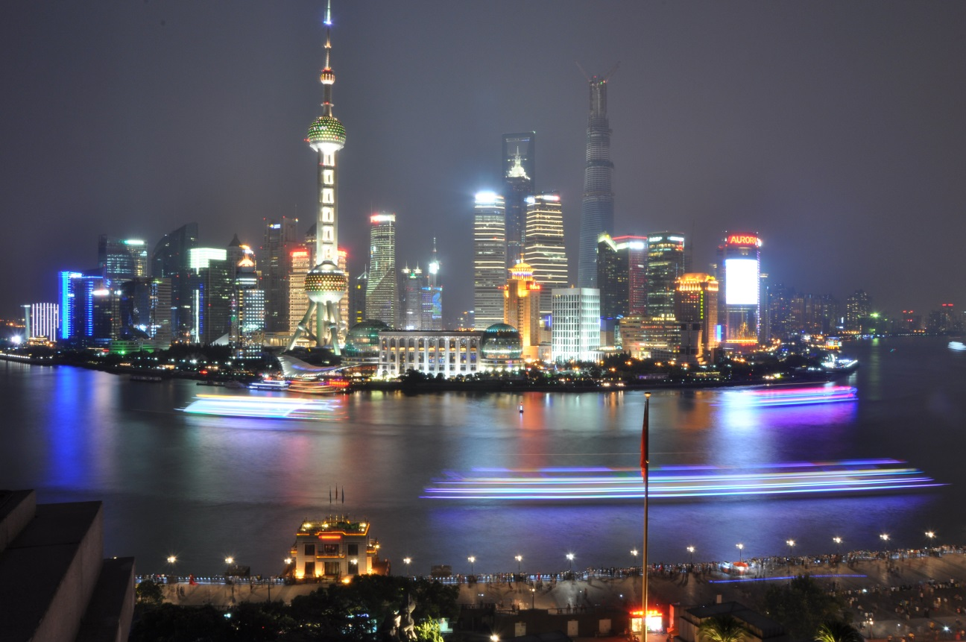
Photography
Shutter Speed
A long shutter speed can be set at night to create light trails, for example, the blurring of the moving vessels (boats) along the river.

Slide 20
Photography
Aperture/Exposure Control
As you’ve already learned from your video lessons, a camera’s aperture is the opening that allows light into the lens (think of the iris in your eye).
Setting the aperture correctly is important for ensuring properly exposed photos (meaning the correct amount of light).
A large aperture setting lets in more light and is useful in more darkly lit situations.
A small aperture setting is better suited for brightly lit scenes.
Most digital cameras feature an auto-exposure setting that automatically adjusts the aperture as lighting conditions change.

Slide 21
Photography
Aperture/Exposure Control
Professional photographers rarely use auto-exposure mode, preferring instead to control the aperture setting themselves.
Different aperture settings are referred to as F-Stops.
The smaller the F-Stop number, the larger the aperture opening (yes, this is a little confusing).
Under-exposed = not enough light (appears too dark)
Over-exposed = too much light (appears washed out)
Under-exposed
Over-exposed

Slide 22
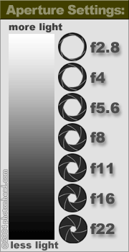
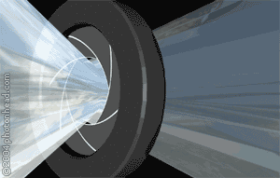
Photography
Aperture/Exposure Control
Brightness is reduced as light passes through the aperture of a camera lens.

Slide 23
Photography
Depth of Field
The camera’s aperture setting also controls the depth of field of your photos.
Depth of field is the range of distance from the camera lens that appears in sharp focus.
The smaller the aperture opening (or higher F-Stop number), the greater the depth of field (or larger range of focus).
The larger the aperture opening (or smaller F-Stop number), the shallower the depth of field (small range of focus).

Slide 24
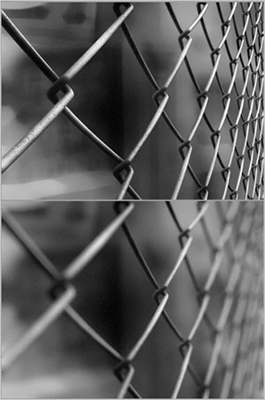
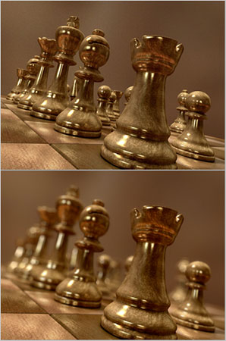
Photography
Depth of Field
Deep DOF
Shallow DOF

Slide 25
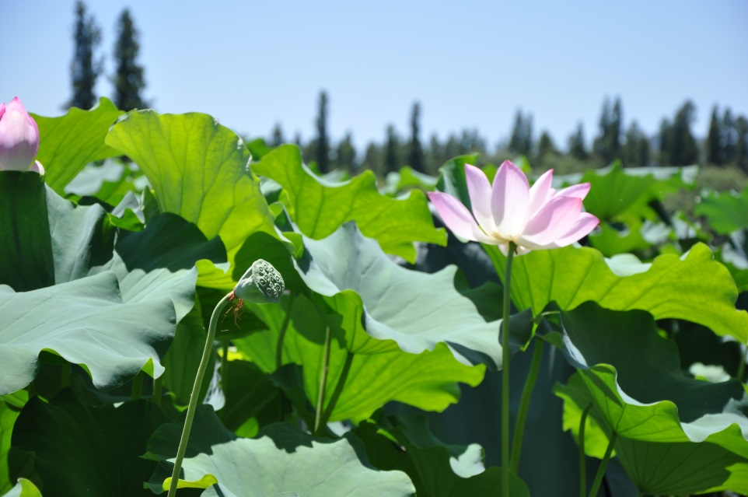
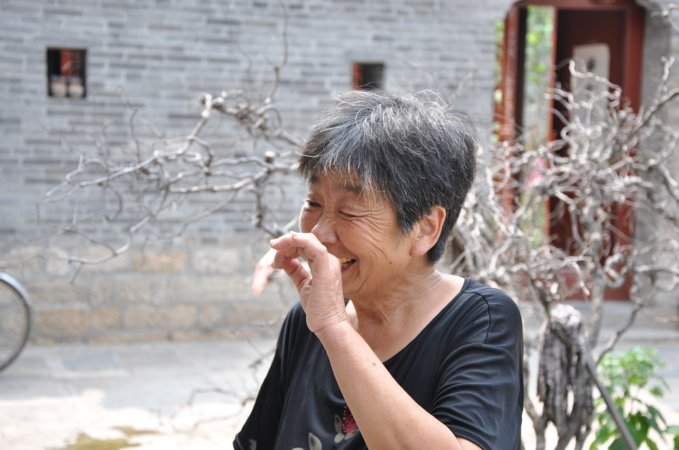
Photography
Depth of Field
Two examples of using a shallow depth of field (DOF) to bring attention to a single element of a photo

Slide 26
Photography
White Balance
White balance adjusts colors based on the light you are shooting (indoor vs. outdoor) – usually referred to as COLOUR TEMPERATURE.
With proper white balancing, white objects in your photos appear as white instead of with an orange or blue cast.
Some digital cameras have an auto-white balance feature, but be careful as it isn’t always accurate.
You can correct white-balance problems on the computer (with programs such as Photoshop).

Slide 27
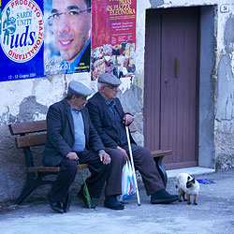
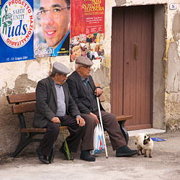
Photography
White Balance
Incorrect White Balance (blue tint) – camera not adjusted for outdoor photos
Correct White Balance camera adjusted for outdoor photos – no unusual tinting

Slide 28
Photography
ISO
ISO refers to the speed at which the camera’s CCD captures the image. This is an adjustable setting on a digital camera; film cameras are manually changed for the ISO film being used.
Lower ISO speeds (200) create a higher quality image but require longer exposure times. Lower speeds are well suited to brightly lit subjects and still life photos.
Higher ISO speeds (1000 or higher) result in quick exposure times with slightly reduced quality. Higher speeds are suited to low light conditions or moving subjects.

Slide 29
Photography
ISO
The image on the right hand side at ISO 3200 has a lot more noise in it (grainy photo), than the one on the left at ISO 200.

Slide 30
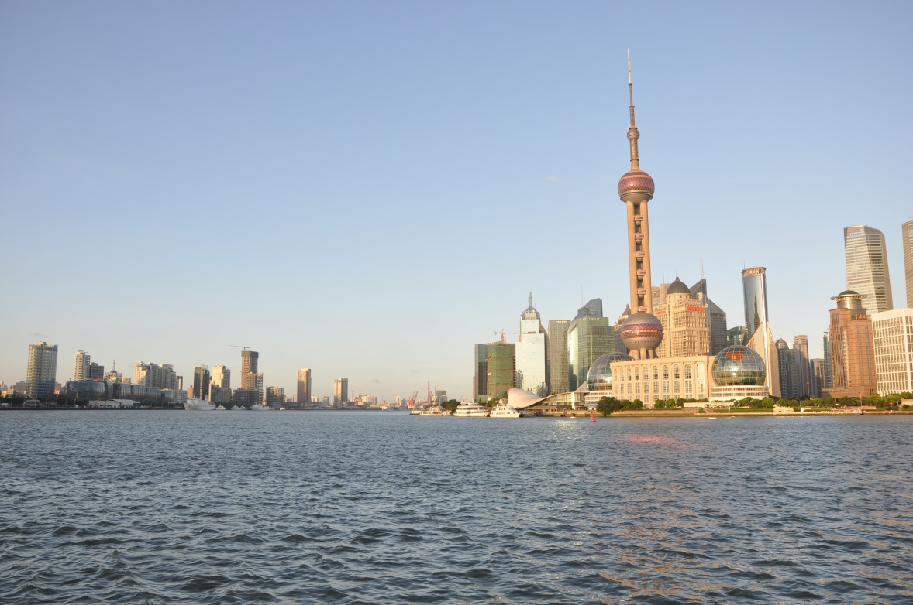
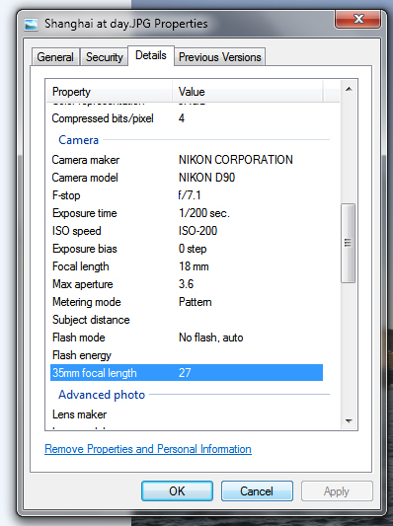
Photography
Photo Properties
With digital photos, many camera imbed data while taking a photo, this is also called “metadata” or “exchangeable image file format” (EXIF) .

Slide 31
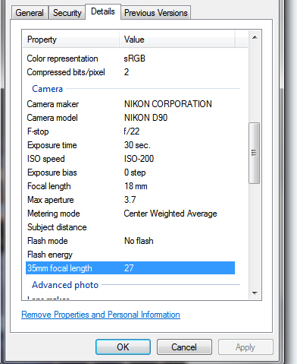
Photography
Photo Properties

Slide 32
Photography
Buying a Camera?
If you are planning on buying a camera, your purchase will depend on your intended use.
Small “point and shoot” cameras are decent for everyday use. Much like a cell phone, point and shoot cameras have limited options, for example, night shots, etc. Three main advantages of point and shoot cameras are: ease of operation, light weight, and are economical (relatively inexpensive).
Digital SLR’s however provide a greater range and quality of use. Much heavier than a point and shoot, the camera lens(s) are exchangeable depending on purpose. Most digital SLR’s have a range of options/settings to suit every situation.

Slide 33
Photography
Buying a Camera? (Pixel Dimension)
Many people make their camera choice based on the photo size, for example, 12 MEG camera.
A pixel is one dot of information in a digital photograph. Digital photos today are made up of millions of tiny dots (Mega = Million).
This means that a 10 megapixel image contains approximately 10 million pixels, while an 18 megapixel image contains 18 million pixels.
Since a photo has a rectangular shape, the dimensions of one side aren't equal to the other. If we assume that we're looking at photo in landscape orientation:
A 10 megapixel photo measures 3872 pixels wide by 2592 pixels high
An 18 megapixel photo measures 5184 pixels wide by 3456 pixels high
If you take the width and multiply it by the height, you get the total number of pixels that make up the digital image:
3872 x 2592 = 10,036,224 pixels = 10 megapixels
5184 x 3456 = 17,915,904 pixels = 18 megapixels

Slide 34
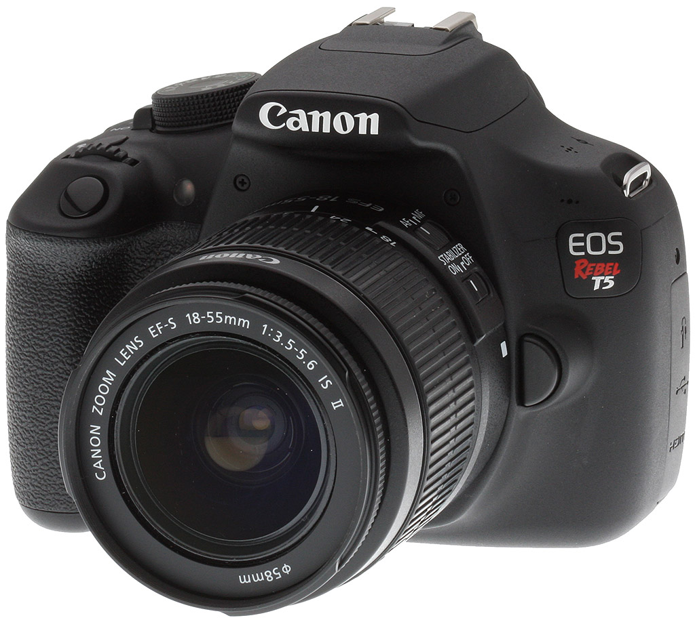
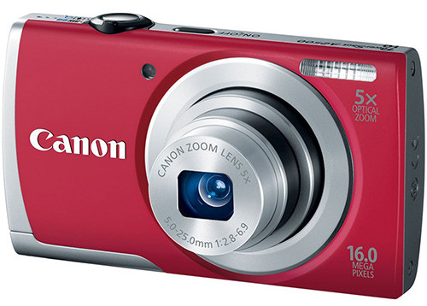
Photography
Point and Shoot vs. Digital SLR
No matter what camera you decide to purchase, it is still the photographer that makes the biggest difference to capture that perfect “shot.”

Slide 35
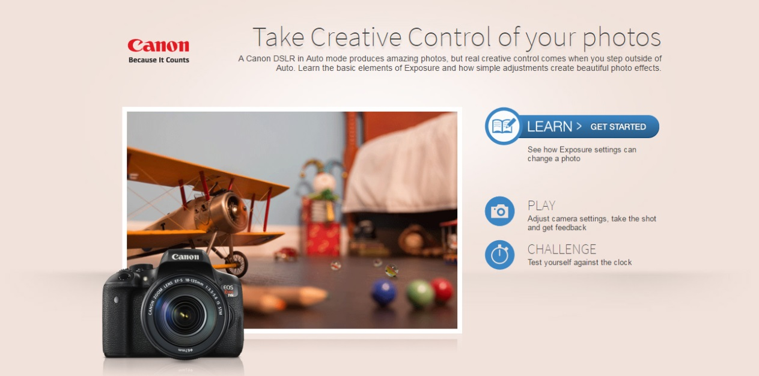
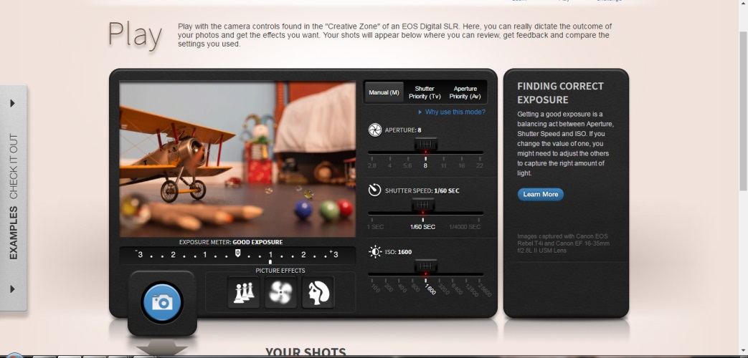
Photography
Practice what you have learned
The following is a really good website to “play” with camera controls, etc. (With permission from Canon) http://www.canonoutsideofauto.ca/

Slide 36
Photography
Prepare for the Quiz
After you have “experimented” or “played” with the website from the last slide, we suggest that you read over the slides to prepare for the quiz.
The “quiz” completes this learning module (or SHSM “Elective certificate”)
Most of all, enjoy taking photos!!

